Slide 1
Hormones involved in Female Reproduction
Prof. Deepthi de Silva
Department of Physiology

Slide 2
At the end of this lecture you should be able to
Outline the synthesis of oestrogens & progesterone
Outline the whole body and reproductive system effects of oestrogen & progesterone
Explain the regulation of the ovarian cycle with regard to the role of FSH, LH, inhibin, oestrogen and progesterone
Outline the role of positive feedback of oestrogen on LH secretion prior to ovulation

Slide 3
Synthesis of Oestrogens: 1
Cholesterol
3 β OH steroid
dehydrogenase
Pregnenolone
Progesterone
17 α Hydroxylase
17α Hydroxypregnenolone
17α Hydroxy-progesterone
17,20 Lyase
Androstenedione
Dehydroepiandrosterone
Dihydrotestosterone
Testosterone
5 α reductase

Slide 4
Synthesis of Oestrogens: 2
Androstenedione
Aromatase
Oestrone
Testosterone
Aromatase
Oestriol
Oestradiol

Slide 5
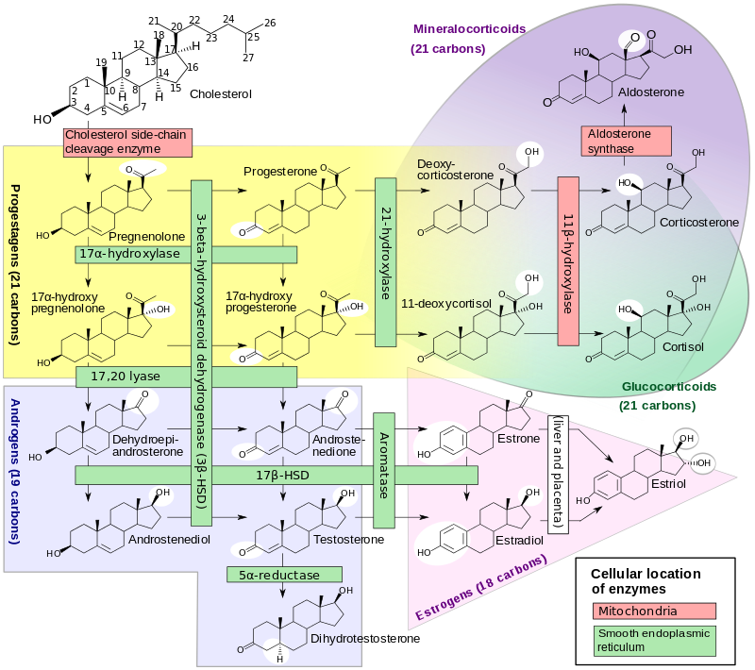

Slide 6
Ovarian Hormones : Oestrogens
17β Oestradiol (E2), Oestrone (E1), Oestriol (E3)
Transported bound to albumin, gonadal steroid binding globulin
2% free
Metabolised in liver; excreted in urine
Secreted during both follicular and luteal phases

Slide 7
Secretion of Oestrogens in Ovary
Cholesterol
Cholesterol
Androstenedione
Androstenedione
Oestradiol
Oestrone
Oestrone
Oestradiol
Circulation
Theca Interna
cells
Granulosa
cells
Antrum

Slide 8
Oestrodiol secretion
First peak
  End of the follicular phase
  Causes +ve feedback of LH secretion and ovulation due to LH peak
2nd peak
  Mid luteal phase
  Levels lower than at the first peak

Slide 9
Actions of oestrogens: Whole body effects
Female appearance: body contours, high voice, hair pattern,
Metabolic - Na+ and water retention
Increased angiotensinogen, thyroid binding globulin
Causes epiphyseal closure (both sexes) at puberty
Reduced risk of atheroma (reduce cholesterol, increases nitric oxide)
Prevention of osteoporosis
Reduces acne

Slide 10
Actions of Oestrogen 2
Accessory sex organs
  Endometrium- proliferative phase
  Myometrium- increased excitability, more sensitive to oxytocin
  Cervix, vagina- thin secretions allowing sperm penetration
  Breasts – duct proliferation
2. Behaviour - increased libido; proliferation of dendrites, synaptic knobs (rats)
3. Feedback on hypothalamus/ pituitary

Slide 11
Mechanism of Actions
Nuclear receptors alpha (ERα) and beta (ERβ)
Evidence of membrane recptors in rapid action
Bind oestrogen and form homo or hetero dimers
Bind DNA to alter transcription of genes
Different tissues have more Erα and ERβ

Slide 12
Artificial oestrogens and drugs with oestrogen like actions
Read up

Slide 13
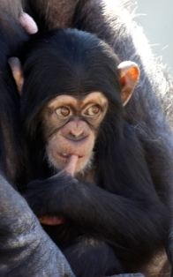
True or false regarding oestrogens?
Oestrone is the most potent oestrogen
Oestradiol synthesis requires aromatase
During a normal menstrual cycle, the highest levels of secretion is during the luteal phase
It stimulates the proliferative phase of the endometrium
It directly stimulates ovulation

Slide 14
Progesterone
[During follicular phase]
Luteal Phase - Corpus luteum produces progesterone
Bound to albumin mainly; 2% free
Metabolised in liver and excreted in urine

Slide 15
Progesterone: mode of action
Binds with intracellular receptors
Releases heat shock protein
This exposes DNA binding site
Heat
shock
protein
Progesterone
DNA binding
site

Slide 16
Progesterone - Actions
Uterus
  Endometrium : increases secretions
  Myometrium : reduces contractility
  Cervix : thick secretions
Breasts : lobular and alveolar development
Increase in basal body temperature (by 0.5^{ο}C)
Stimulation of respiration (lowers PaCO₂)
Feedback effects at high levels
  - Inhibit LH, GnRH, potentiate oestrogen inhibitory effects (prevent ovulation)

Slide 17
Other ovarian Hormones
Inhibin : (from granulosa cells) Inhibits FSH secretion
Relaxin : relaxation of the pelvic girdle
Androgens : increases libido, pubic and axillary hair and acne

Slide 18
True or false regarding progesterone?
It is secreted mainly during the follicular phase
It increases endometrial secretions
At high levels, it inhibits LH secretion
It lowers the PaO2 level
When it binds its receptor, a heat
shock protein is released

Slide 19
Can you?
Outline the synthesis of oestrogens & progesterone
Outline the whole body & reproductive system effects of oestrogens & progesterone

Slide 20
Hormonal Regulation of the Ovarian cycle
At the end of this lecture you should be able to
Explain the regulation of the ovarian cycle with regard to the roles of FSH, LH, inhibin, oestrogen and progesterone
Outline the role of positive feedback of oestrogen on LH secretion prior to ovulation

Slide 21
Regulation of the ovarian cycle
Follicular Phase
Follicular phase
17-hydroxy
progesterone
FSH level high
Inhibin A level low
FSH → follicle development
Follicle secretes oestradiol
Rising oestradiol inhibits LH
Oestradiol
Inhibin
LH
FSH
Day 25 27 1 3 5 7 9 11 13

Slide 22
Ovulation
Oestrogen levels rise >150pg/mL for more than 36 – 48 hours
+ve feedback effect occurs resulting in a LH surge
FSH also rises (due to GnRH surge)
LH peak stimulates ovulation around 9 hours later
LH also maintains the corpus luteum

Slide 23
Luteal Phase
Basal body temperature
Oestrogen, progesterone, inhibin levels rise
-ve feedback on the pituitary: inhibits release of LH (by oestrogen) & FSH (by inhibin)
Corpus luteum degeneration → fall in oestrogen, progesterone
Rise in FSH levels for next cycle
Progesterone
Oestrodiol
Inhibin B
LH
FSH
Day 15 17 19 21 23 25 27

Slide 24
Summary of Hormonal regulation of the ovarian cycle
Hypothalamus
Anterior pituitary
Oestrogen
Inhibin
+ve /
-ve
feedback
LH
FSH
-ve feedback
Theca interna
Granulosa cells

Slide 25
True or false regarding a normal
32-day menstrual cycle?
On day 26, LH secretion is inhibited by oestrogen
FSH secretion starts to increase around day 30
FSH secretion is inhibited mainly by inhibin
Positive feedback occurs for LH secretion
Ovulation occurs after the LH
surge on day 18

Slide 26
Can you?
Explain the regulation of the ovarian cycle with regard to the role of FSH, LH, inhibin, oestrogen & progesterone
Outline the role of positive feedback of oestrogen on LH secretion prior to ovulation

